Slide 2
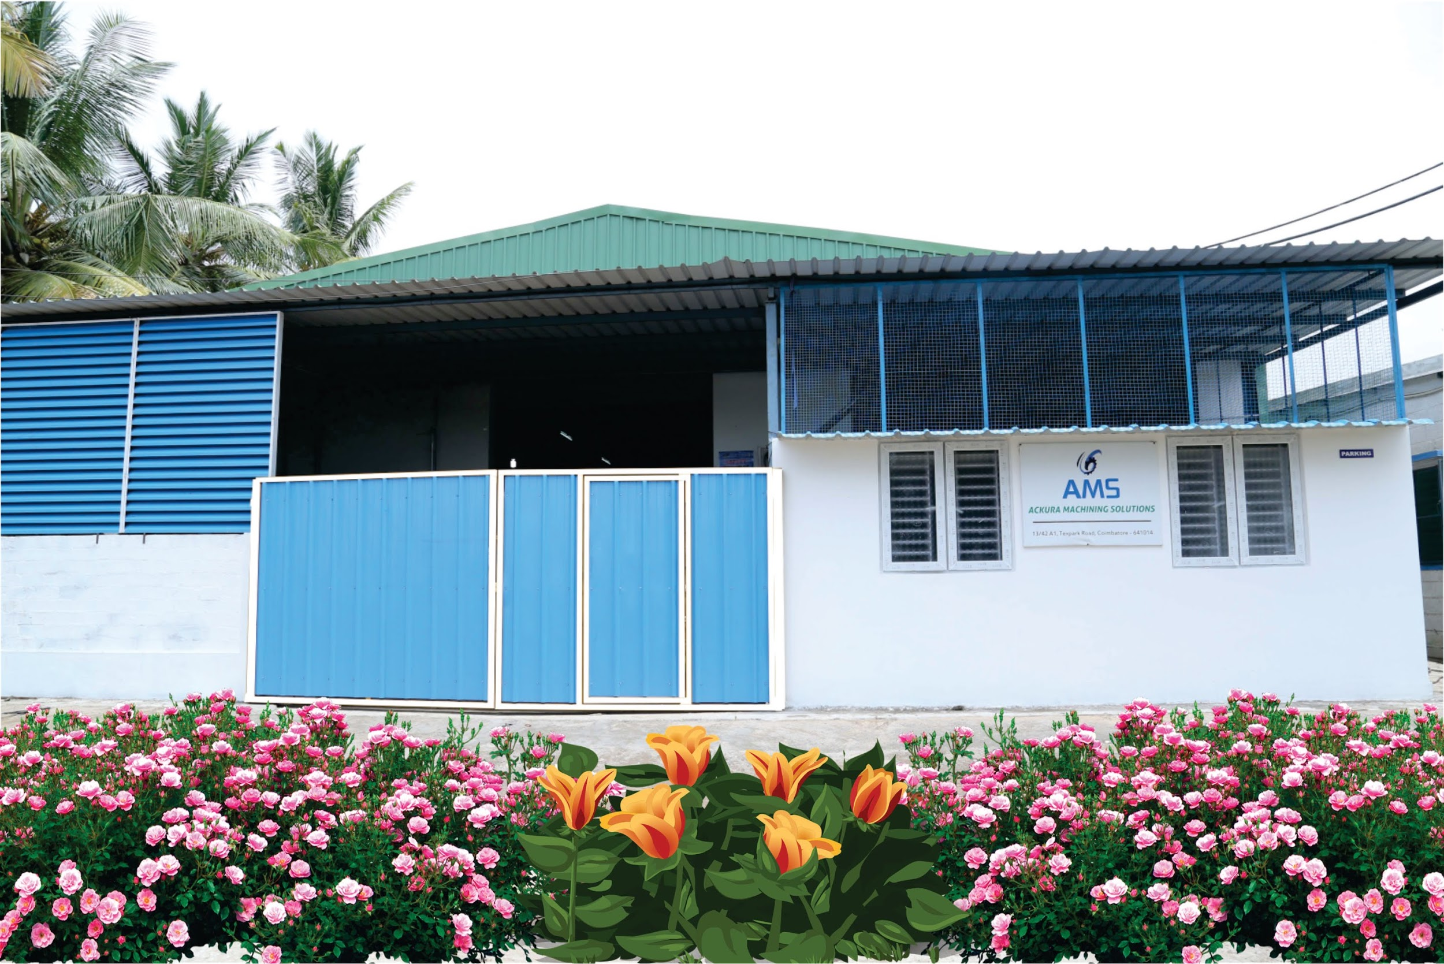
Notes:
2
2
2
2

Slide 3
ACKURA MACHINING SOLUTIONS
13/42A1, Tex park Road,
Coimbatore -641014
India.
Phone :0422 -6506006, 9042016002
E-mail : ackurams@gmail.com

Slide 4
AGENDA
ABOUT US
OUR MISSION
OUR QUALITY POLICY
INFRASTRUCTURE
WORK FORCE
ACTIVITIES
OUR PARENTAL COMPANY
OUR MACHINING ASSOCIATES
OUR PARTNERS COMPANY
OUR FOUNDRY ASSOCIATES

Slide 5
ABOUT US
Ackura Machining Solutions is a Pioneer Manufacturing
of Engineering Components. We offer an excellence
service to wide range of Engineering Services and
Manufacturing that includes Automobile, Textile, Marine
Industries and General Engineering.

Slide 6
OUR MISSION
To Progress with customers by excellence in
Machining Solutions and Quality by continual
Improvement and systems.

Slide 7
OUR QUALITY POLICY
We at AMS make persistent efforts to satisfy the customer and other
applicable requirements, which we give top priority and believe that the
purpose of our business. We ensure this in each business interaction through,
Supply of Quality Products on-time
Implementing, Maintaining and Improving a Quality Management system
Technical up-gradation to suit Market demands
Enhancing the knowledge levels of Employees
Compliance with Statutory & Regulatory requirements
Motivation & Team work

Slide 8
OUR ESTEEMED EXPORT CUSTOMERS
TWIN DISC INCORPORATED, US
Manufacturers of PTO Housings for Marine Engineering
OUR ESTEEMED CUSTOMERS IN ENQUIRY
SIEMENS
Notes:
8
8
8
8

Slide 9
INFRASTRUCTURE
ACKURA MACHINING SOLUTIONS is equipped with
state-of the-art infrastructure that includes
CNC GEAR SHAPER
VERTICAL BROACHING MACHINE
CONVENTIONAL MACHINERIES
For accurate measurement requirements,
ACKURA MACHINING SOLUTIONS is also fully equipped with
2DHEIGHTMASTER
PNEUMATICGAUGES,MITUTOYO ROUGHNESS TESTER.
CMM
and a host of other required Gauges and Instruments.
Notes:
9
9
9
9

Slide 10
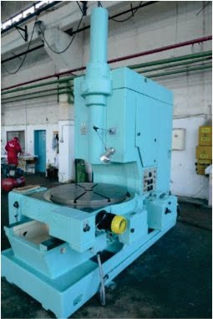
MACHINERY DETAILS
STANKO GEAR SHAPING MACHINE
MAKE : STANKO
ORIGIN : RUSSIA
MODEL : 5B150P
SPECIFICATION
Max diameter of gears cut: 800 mm
Max module: 12 mm
Max cutter stroke: 200 mm
Max cutter diameter: 200 mm
Saddle indexing gear diameter: 360 mm
Cutter arbor diameter: 44.443 mm
Spindle bore taper: No. 5 Morse
Notes:
10
10
10
10

Slide 11
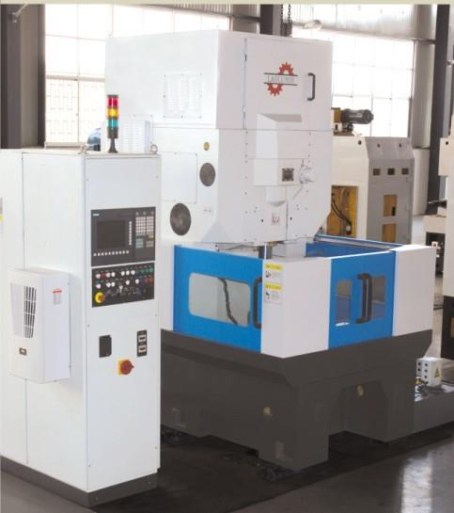
LAOLUNSI CNC GEAR SHAPING MACHINE
MAKE : Zhejiang Lawrence Machine Tool Co., Ltd.,
ORIGIN : CHINA
MODEL : YL5150CNC
SPECIFICATION

Slide 12
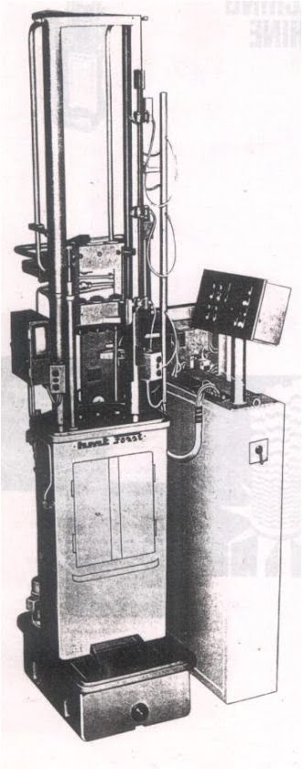
HMT VERTICAL BROACHING MACHINE
MAKE : Hindustan Machine Tools
ORIGIN : INDIA
MODEL : RIZS 25 X 1600
SPECIFICATION
Max Pulling Force kg. 25,000
Max Stroke mm. 1600
Feeder Stroke for Change of Component mm 630
Follow on Stroke of feeder mm. 1400
Cutting Speed (Infinitely Variable M / Min 7.5
Return Stroke Speed M / Min 24
With of face plates mm. 500
Notes:
12
12
12
12

Slide 13
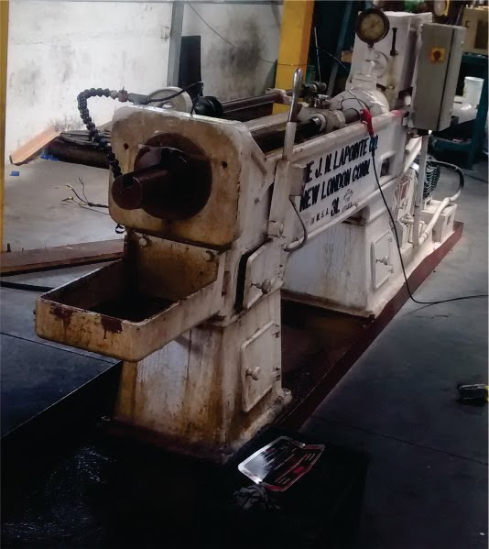
HORIZONTAL BROACHING MACHINE
MAKE : Laponite
ORIGIN : USA
MODEL : W69019
SPECIFICATION
Max Capacity 10,000 LBS
Stroke 48 inches
Notes:
13
13
13
13

Slide 14
VERTICAL ABRO BALANCING MACHINE
MAKE : ABRO
ORIGIN : INDIA
VERTICAL TOOTH CHAMFERING MACHINE
MAKE : GRIND TECH
ORIGIN : INDIA
VERTICAL BALANCING MACHINE
MAKE : MACHINERY VIBRATION CONTROL SYSTEMS
ORIGIN : INDIA
VERTICAL TOOTH CHAMFERING MACHINE
MAKE : BAARATHWAJ INDUSTRIES
ORIGIN : INDIA
Notes:
14
14
14
14

Slide 15
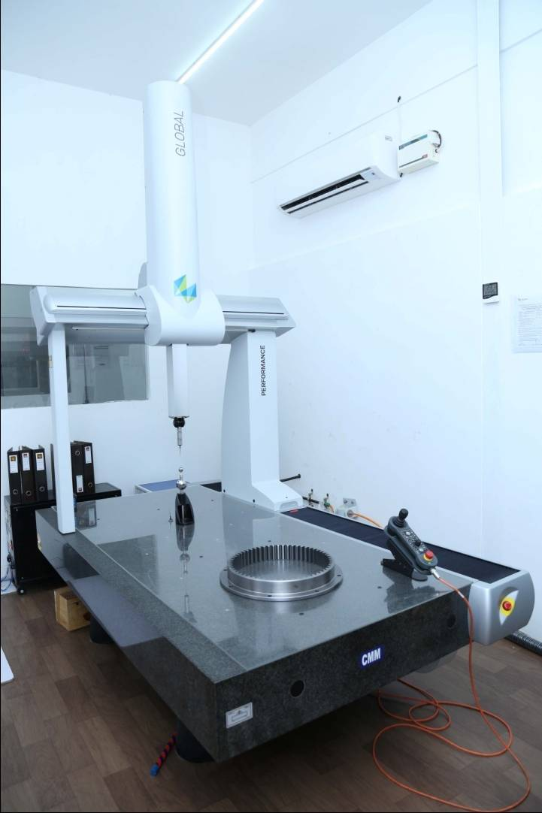
COORDINATE MEASURING MACHINE
MAKE : Brown & Sharp
ORIGIN : INDIA
MODEL : GLOBAL SILVER PERFORMANCE 9158
SPECIFICATION
Max Xaxis 900 mm
Max Yaxis 1500 mm
Max Zaxis 800 mm
With Gear Scanning Software & Curve analyzer Software
Notes:
15
15
15
15

Slide 16
MEASURING FACILITIES
2000/1000 mm Granite Surface Table
0-500 mm Internal Micro Meters
0-600 mm External Micro Meters
0-600 mm Internal Bore Stem & dial
0-600 mm Height Vernier
Pistol Calipers
0-150 mm Digital Vernier
0-300 mm Digital Vernier
Air Guages
Notes:
16
16
16
16

Slide 17
PROPOSED MEASURING INSTRUMENTS
Trimos 2D Measuring 1100 mm with electronic Probe
Hardness Testers
Profile Projectors
Notes:
17
17
17
17

Slide 18
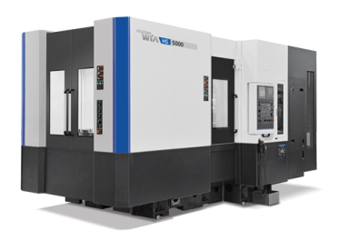
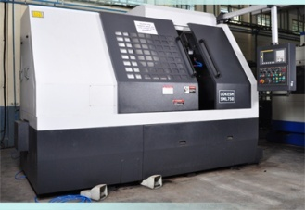
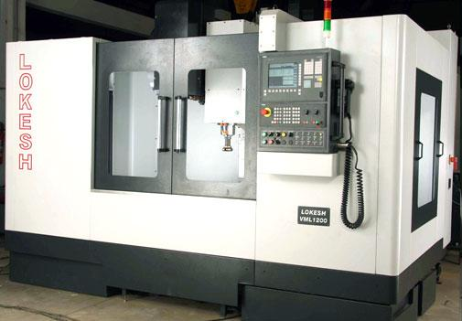
PROPOSED MACHINERIES
Hyundai Wia Horizontal Machining Centre
2. Vertical turning Centre
3. Turning Centre
4. Vertical Machining Centre

Slide 19
WORK FORCE
The core of ACKURA MACHINING SOLUTIONS has dedicated workforce of more than 20 Trained and Skilled employees. The fact that all of them have been locally sourced is added strength for the Organization.
Our team of qualified and trained Engineers manage the key are as of Planning, Production Quality Assurance, and Maintenance in alignment with our company objectives.

Slide 20
ACTIVITIES
CNC machined precision Components used for Automobiles, Textile Machines and other General Engineering Component.
We undertake the parts for machining and manufacturing from
1.Drawn bars of all type of General steels, Stainless Steels, Aluminum,
Brass etc.
2.Castings of Steel, Stainless Steel, Greyiron, Ductile iron, Non Ferrous and Special alloys,
3.Forgings of all type of steels, non-ferrous like Aluminum, Brass Copper etc.
4.Investment castings of Steels and Stainless Steels.

Slide 21
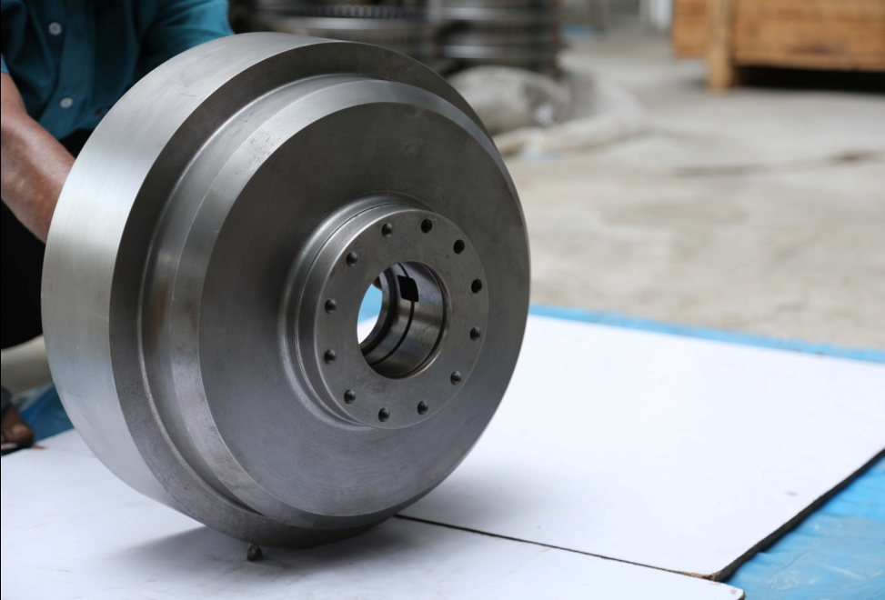
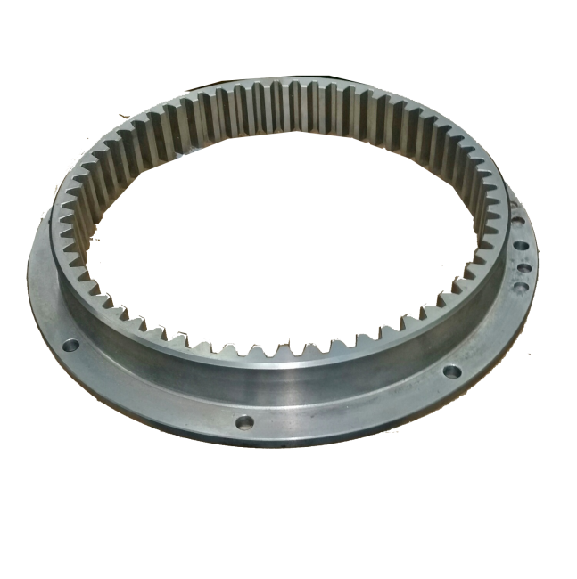
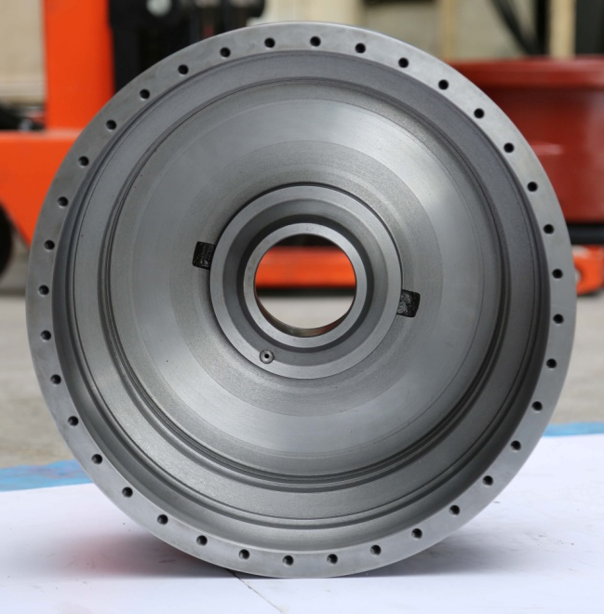
OUR MACHINED COMPONENTS PHOTOS
Notes:
21
21
21
21

Slide 22
CONTACT PERSON
R. VENUGOPAL – 90420 16002
R. RAJENDRAN – 73977 44928
Thanking You…
ACKURA MACHINING SOLUTIONS
Notes:
22
22
22
22

